Slide 1
Gestures recognition on embodied mirroring system
Professor:
Alessandra Pedrocchi
Tutors:
Laura Santos
Alice Geminiani
Dibennardo Federica
Pozzi Luca
Ratti Alessio
Neuroengineering
A.Y. 2019/2020
Milan, Dec 19, 2019

Slide 2
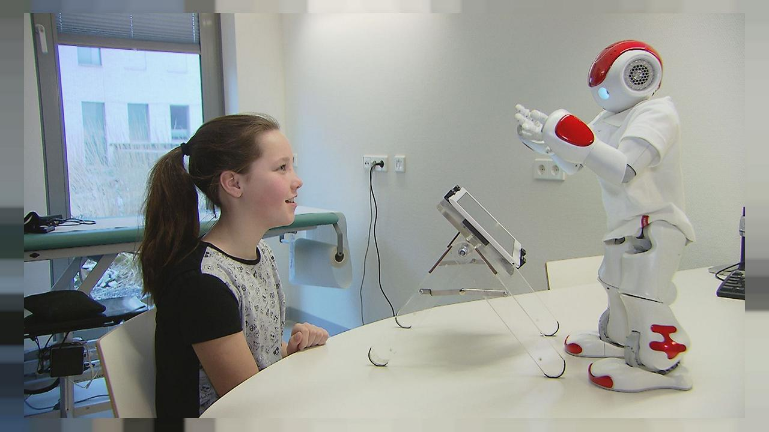
Background and aim
Embodied mirroring interactive games have been suggested as a tool to enhance traditional therapy for autistic children.
Aim of the project
social
cognitive
motor
Figure 1: Children interaction with NAO. https://www.euronews.com/2017/03/13/robots-interact-with-children-to-help-with-their-diabetes
Develop an efficient algorithm for gesture recognition captured by a Kinect, to be used within an embodied mirroring setup for autism therapy.
2 | Speaker: Dibennardo Federica

Slide 3
Workflow
Acquisition
Data Preparation
Implementation and testing
Data Analysis
Model formulation
Development of algorithm
3 | Speaker: Dibennardo Federica

Slide 4
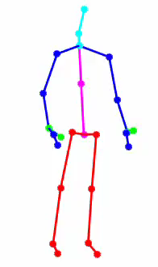
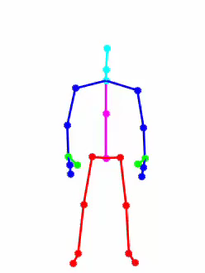
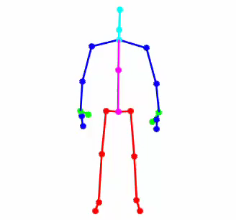
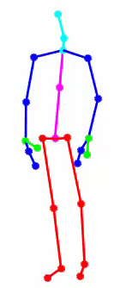
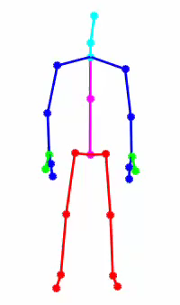
5 recorded gestures + random
‘waving’
‘small’
‘pointing’
‘yes’
‘come’
4 | Speaker: Dibennardo Federica

Slide 5
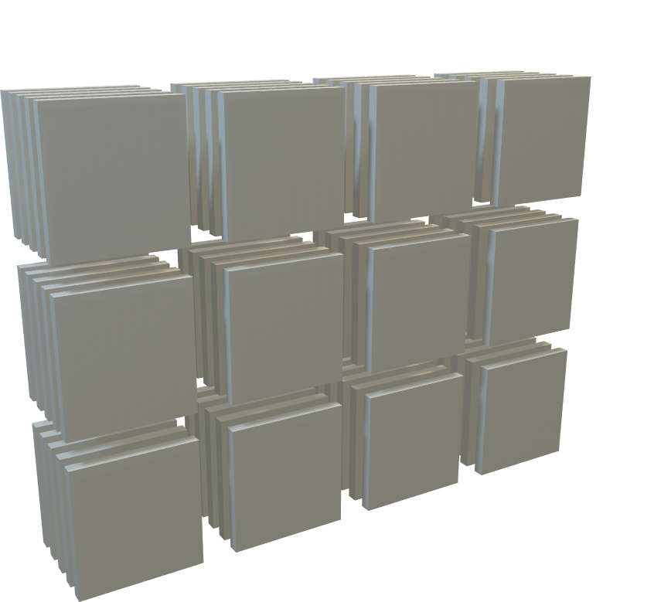
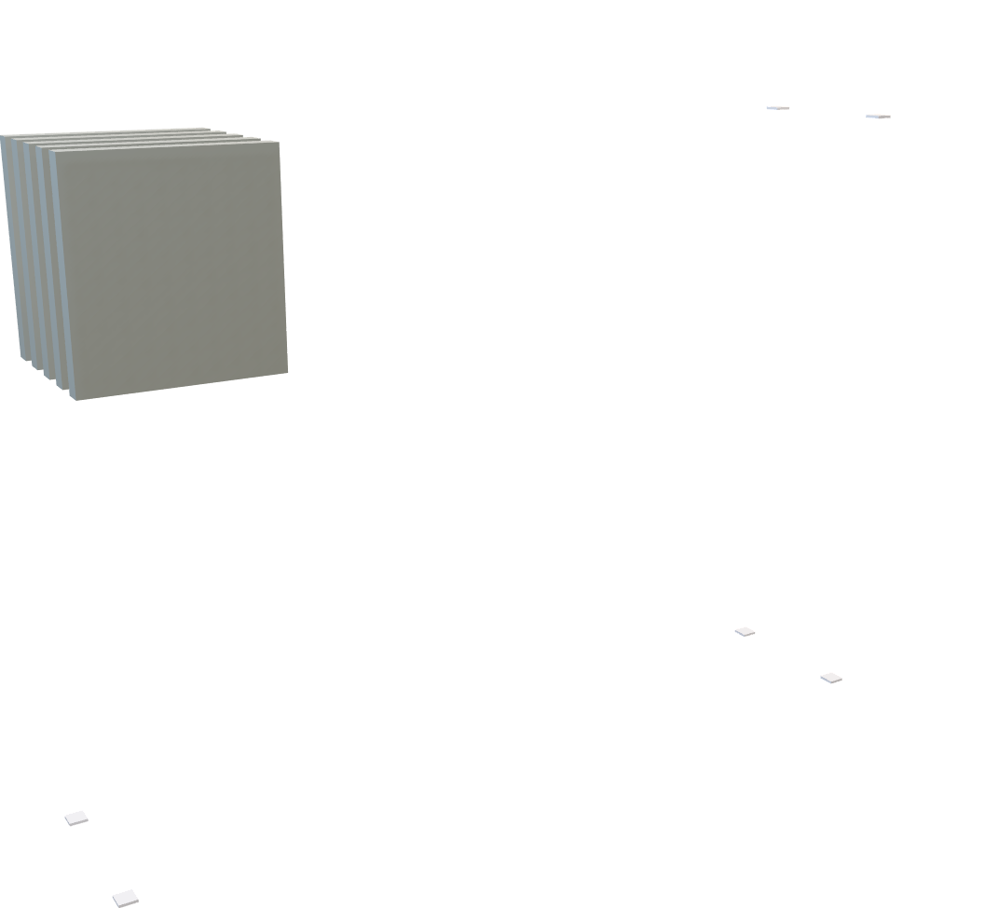
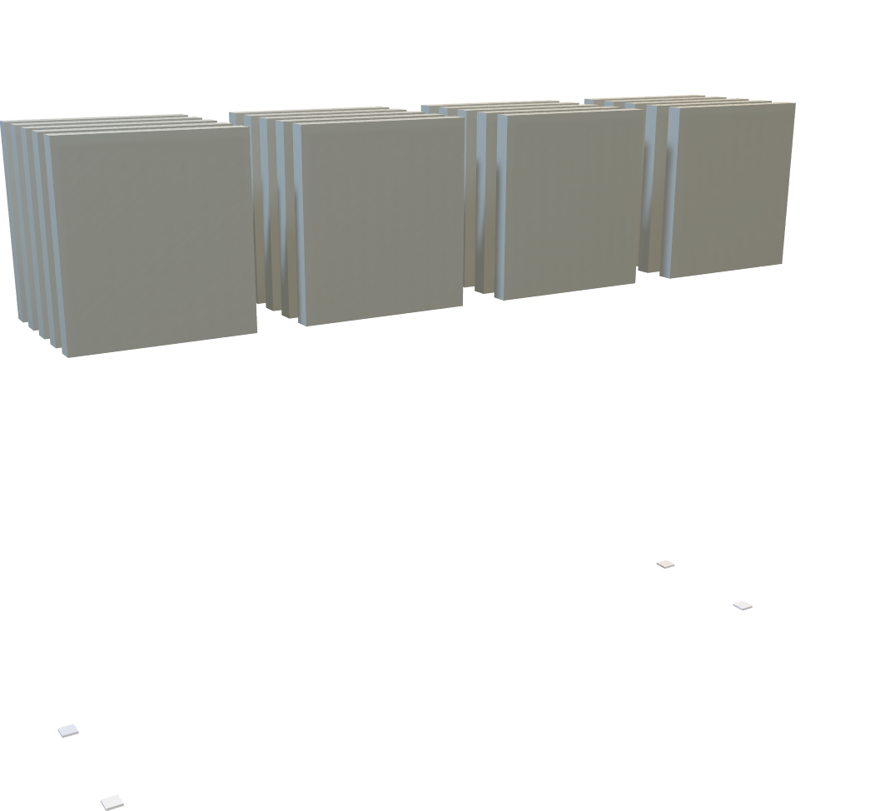
Data manipulation
j
High dimensionality:
Time
Joints coordinates
Repetitions
Gestures
High dimensionality:
Time
Joints coordinates
Repetitions
High dimensionality:
Time
Joints coordinates
Repetitions
Gestures
Subjects
t
r
gestures
subjects
5 | Speaker: Pozzi Luca

Slide 6
Classes richness overview
Dataset
(1436 samples)
Train: 70%
Test: 30%
6 | Speaker: Pozzi Luca

Slide 7
Data augmentation
Implemented techniques:
Mirroring along the plane orthogonal to the x-axis
White gaussian noise added
→ Database reached up to 4 times the initial richness (factorial method)
As acquired
Gaussian noise
Mirrored
G noise & mirroring
7 | Speaker: Pozzi Luca

Slide 8
Feature extraction foundation
Cartesian coordinates
[X, Y, Z]
Still frame
Motion capture
Relative distance between joints
Velocity
Acceleration
Chart 1:Yang et al. (arXiv, 2019). (adapted)
8 | Speaker: Pozzi Luca

Slide 9
Rationale behind the CNN
Adopted network layout:
Convolutional + ReLU + Max Pooling
Multi-stream input
Single Softmax dense layer output
Parameters:
Adaptable lr: 1e-3 – 1e-6
500’000 trainable parameters
62’000 FPS reached during training (Tesla K80 NVIDIA GPU)
Variable gesture length
Chart 2:Yang et al. (arXiv, 2019). (adapted)
9 | Speaker: Ratti Alessio

Slide 10
Cutting down training time
87.70 %
88.39 %
88.39 %
88.17 %
71.69 %
Validation accuracy
10 | Speaker: Ratti Alessio

Slide 11
CNN performance with augmented data
90.72 %
91.65 %
93.16 %
Validation accuracy
11 | Speaker: Ratti Alessio

Slide 12
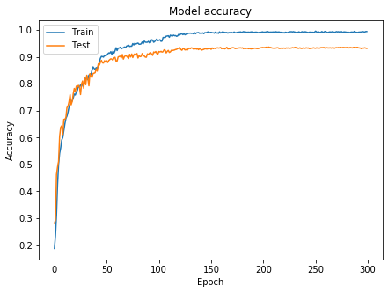
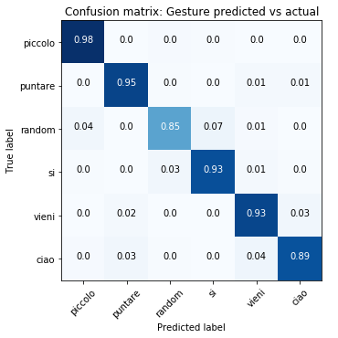
2 second (50 frames) | mirrored + gaussian noise augmented data
12 | Speaker: Ratti Alessio

Slide 13
Final remarks
Data preparation is key.
Real-time applications. Feasibility?
Figure 2: TensorFlow Lite performance assessment. https://github.com/EdjeElectronics/TensorFlow-Lite-Object-Detection-on-Android-and-Raspberry-Pi/blob/master/Raspberry_Pi_Guide.md
13 | Speaker: Ratti Alessio

Slide 14
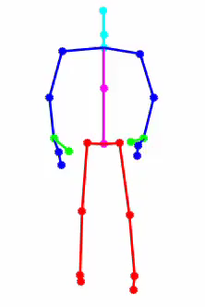
Q & A
Figure 3: realDonaldTrump (2017, Nov 21) [Twitter post]
14

